Slide 1
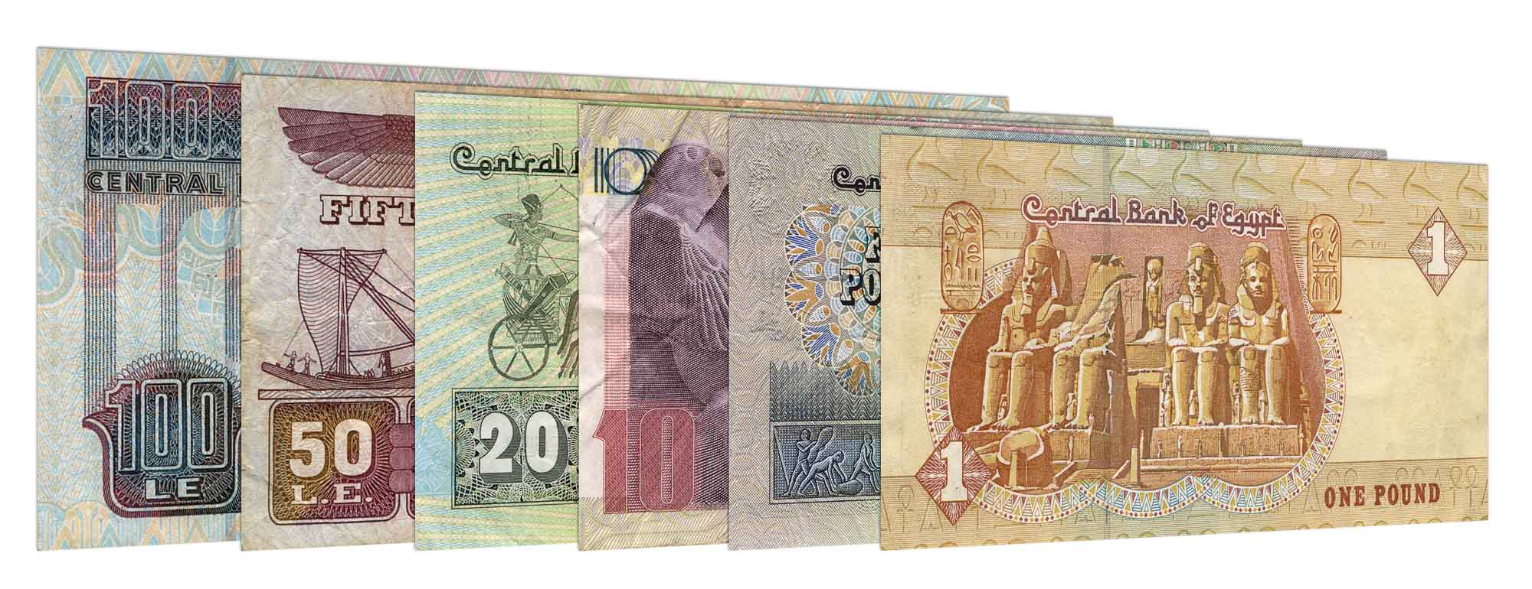
Currency recognizer
Currency recognition model using KNN, histogram, texture, and ORB features
Improves quality of life for visually impaired individuals
Key benefits:
Enhanced autonomy: Enables independent financial management
Increased confidence: Boosts self-assurance in daily tasks and social interactions
Reduced risk of fraud: Accurate identification of currency denominations
Overall impact: Contributes to better quality of life and inclusive society

Slide 2
Modular Decomposition
Image Acquisition
- Step-by-step process:
- Image Acquisition: Capture and collect currency images
- Preprocessing: Enhance input images (resizing, denoising, normalization)
- Feature Extraction: Extract histogram, texture, and ORB features
- Dimensionality Reduction: Transform original feature space into lower-dimensional space using PCA
- KNN Classification: Apply k-Nearest Neighbors algorithm for recognition
Preprocessing
Feature Extraction
Dimensionality Reduction
KNN Classification

Slide 3
Modular Decomposition
Image Acquisition
Currency Recognition – Image Acquisition and Data Preprocessing
Currency images are captured using our application and transmitted for preprocessing and detection in this model
Preparing the input dataset and ensuring images are suitable for feature extraction
Objective: Augment dataset and enhance model robustness for better recognition performance
Preprocessing
Feature Extraction
Dimensionality Reduction
KNN Classification

Slide 4
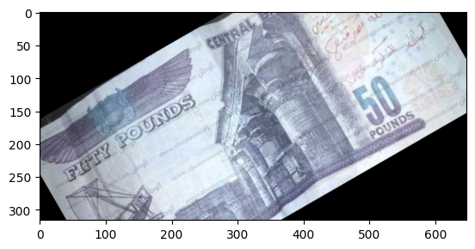
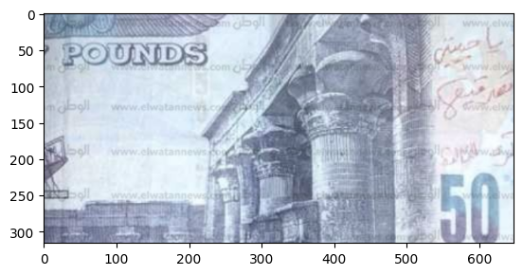
Modular Decomposition
Image Acquisition
Currency Recognition – Image Acquisition and Data Preprocessing
Rotation and Scaling
Functions used: rotate(img, angle) and scale(img, scale)
Purpose: Introduce variability in image orientation and size
Rotation: Apply different angles to input images to account for real-world variations
Scaling: Adjust image dimensions to normalize image sizes and improve computational efficiency
Preprocessing
Feature Extraction
Dimensionality Reduction
KNN Classification

Slide 5
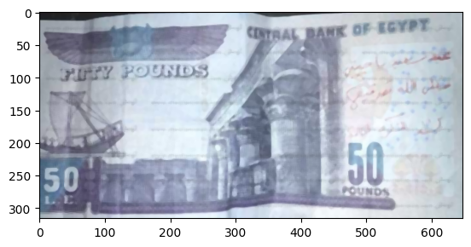
Modular Decomposition
Image Acquisition
Currency Recognition – Image Acquisition and Data Preprocessing
Noise Removal
Function used: remove_noise(img, method)
Purpose: Eliminate noise from input images to improve feature extraction accuracy
Noise removal techniques: Gaussian, Median, Non-local Means, and others
Enhance image quality by reducing distortions and artifacts
Preprocessing
Feature Extraction
Dimensionality Reduction
KNN Classification

Slide 6
Modular Decomposition
Image Acquisition
Currency Recognition – Image Acquisition and Data Preprocessing
Blurring
Function used: blur(img, blur_type)
Purpose: Simulate the effect of out-of-focus images and account for different imaging conditions
Blurring techniques: Average, Gaussian, Median, and Bilateral
Helps improve classifier performance by handling varying degrees of image sharpness
Preprocessing
Feature Extraction
Dimensionality Reduction
KNN Classification

Slide 7
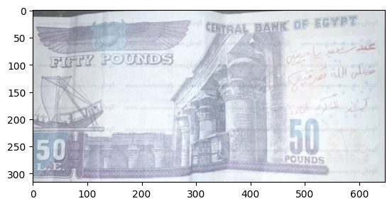
Modular Decomposition
Image Acquisition
Currency Recognition – Image Acquisition and Data Preprocessing
Lighting Adjustment
Function used: lighting(img, lighting_type)
Purpose: Adapt to different lighting conditions and address illumination variations in input images
Lighting adjustments: Brightness, Contrast, Gamma Correction, Histogram Equalization
Increases model robustness by handling diverse lighting scenarios encountered in real-world applications
Preprocessing
Feature Extraction
Dimensionality Reduction
KNN Classification

Slide 8
Modular Decomposition
Image Acquisition
Currency Recognition – Feature Extraction
Third stage of the currency recognition model for visually impaired people
Importance of generating a comprehensive feature vector to represent currency images
Combine histogram, texture, and ORB features to create a comprehensive feature vector
Utilize feature vector as input for the k-Nearest Neighbors (kNN) algorithm during classification
Objective: Accurately classify different currency denominations using extracted features
Preprocessing
Feature Extraction
Dimensionality Reduction
KNN Classification

Slide 9
Modular Decomposition
Image Acquisition
Currency Recognition – Feature Extraction
Histogram Features
Extract color information using histograms
Graphical representation of color value distribution in an image
Computed for each color channel (e.g., Red, Green, and Blue)
Concatenate histograms to form a single feature vector
ORB Features
Oriented FAST and Rotated BRIEF (ORB) algorithm for keypoint and descriptor extraction
Invariant to rotation, scale, and illumination changes
Identify distinctive points (keypoints) in images and compute binary descriptors
Capture local patterns around keypoints for classification
Preprocessing
Feature Extraction
Dimensionality Reduction
KNN Classification

Slide 10
Modular Decomposition
Image Acquisition
Currency Recognition – Feature Extraction
Texture Features
Capture structural and textural details of banknotes
Methods: Gray-Level Co-occurrence Matrix (GLCM) or Local Binary Patterns (LBP)
Analyze relationships between neighboring pixels
Encode presence of patterns, such as edges, corners, and textures
Preprocessing
Feature Extraction
Dimensionality Reduction
KNN Classification

Slide 11
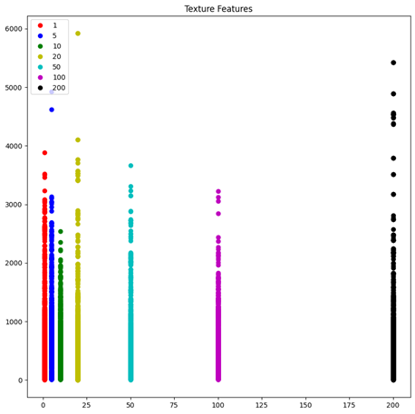
Modular Decomposition
Image Acquisition
Currency Recognition – Feature Extraction
Preprocessing
Feature Extraction
Dimensionality Reduction
KNN Classification
GLCM of each currency which shows difference in texture for each cuurency

Slide 12
Modular Decomposition
Image Acquisition
Currency Recognition – Dimensionality Reduction
Dimensionality reduction using Principal Component Analysis (PCA)
Address issues of redundant information and computational complexity
Key steps:
1. Standardize feature data
2. Determine optimal number of principal components
3. Apply PCA with optimal number of components
4. Update feature vector
Lower-dimensional representation used as input for kNN algorithm during classification stage
Preprocessing
Feature Extraction
Dimensionality Reduction
KNN Classification

Slide 13
Modular Decomposition
Image Acquisition
Currency Recognition – Dimensionality Reduction
Final stage: Classification using k-Nearest Neighbors (kNN) algorithm
Key steps:
Training kNN classifier
Choosing value of 'k’
Distance metric
Classification: Calculate distance between input image's feature vector and training dataset, assign majority class among 'k' nearest neighbors
Outcome: Accurate recognition of different currency denominations for visually impaired users
Preprocessing
Feature Extraction
Dimensionality Reduction
KNN Classification

Slide 14
System testing and Verification
Evaluate k-NN classifier performance for various 'k' values and distance metrics
Test results:
k = 3:
91% accuracy with Euclidean distance
89% accuracy with Hamming distance
k = 5:
92% accuracy with Euclidean distance
89% accuracy with Hamming distance
k = 7:
93.5% accuracy with Euclidean distance
90% accuracy with Hamming distance
Best performing combination:
k = 7 with Euclidean distance metric (93.5% accuracy)

Slide 15
Limitations
Key constraints affecting currency recognition model:
Feature integration
Feature dimensionality
Feature scaling
Computational complexity
Memory requirements
Robustness

